Slide 1
Two-way ANOVA
with replications

Slide 2
Two-way ANOVA- with replications
Purpose of the test: The purpose of the test is to determine the effects of two factors on the response variable and, if there is interaction between the factors, to determine the nature of the interaction.
Assumptions: (1) The distribution of the response is Normal. (2) The variance for each treatment is identical (3) The samples are independent.

Slide 3
Other considerations
Balanced design – the same number of observations are made for each treatment.
The factor interaction component is used to test whether the factors combine to affect the response while the factor main effect components are used to determine whether the factors separately affect the response.

Slide 4
Example
An amusement park has been studying methods for decreasing the waiting time (minutes) on rides by loading and unloading riders more efficiently.
Three alternative loading/unloading methods have been proposed on the three types of rides at the park.
A 2-factor design with two replications was employed in the experiment and the results were as follows. Test for any significant effects.

Slide 5
Type of Ride
M
e
t
h
o
d
 | Roller Coaster | Screaming Demon | Log Flume | Total
M₁ | 16, 18 | 19, 17 | 23, 20 | 113
M₂ | 19, 20 | 25, 23 | 19, 18 | 124
M₃ | 22, 21 | 21, 24 | 19, 17 | 124
Total | 116 | 129 | 116 | 361

Slide 6
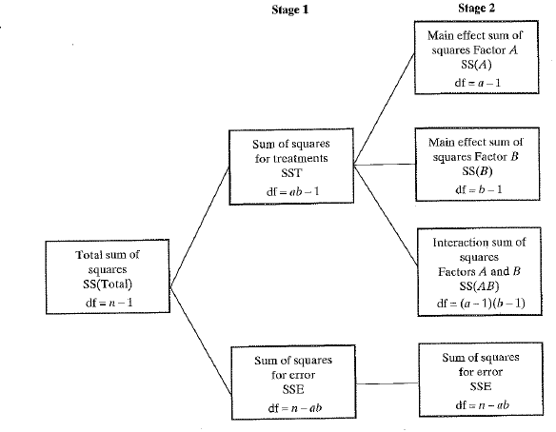
Partitioning the Total Sum of Squares for a Two-Factor Factorial Experiment

Slide 7
Interactions
Let the two factors under investigation be called Factor A and Factor B. The effect of each factor alone is that factor’s main effect.
The combined effects of the two factors, beyond what we may expect from the consideration of each factor separately, is the interaction between the two factors.
Two factors are said to interact if the differences between levels of one factor depends on the level of the other factor.
Factors that do not interact are called additive.

Slide 8
An interaction is thus an extra effect that appears as a result of a particular combination of a level from one factor with a level from another factor.
The three questions answerable by two-way ANOVA are:
Are there any interaction effects of Factors A and B?
Are there any “Factor A” main effects?
Are there any “Factor B” main effects?

Slide 9
Response Plots (to detect interactions).
Plot the data against the levels of one factor, for each level of the second factor.
Note that, when interactions are present, main effects cease to have much meaning.
E.g. Response plots for an experiment with three levels of factor A and two levels of factor B:

Slide 10
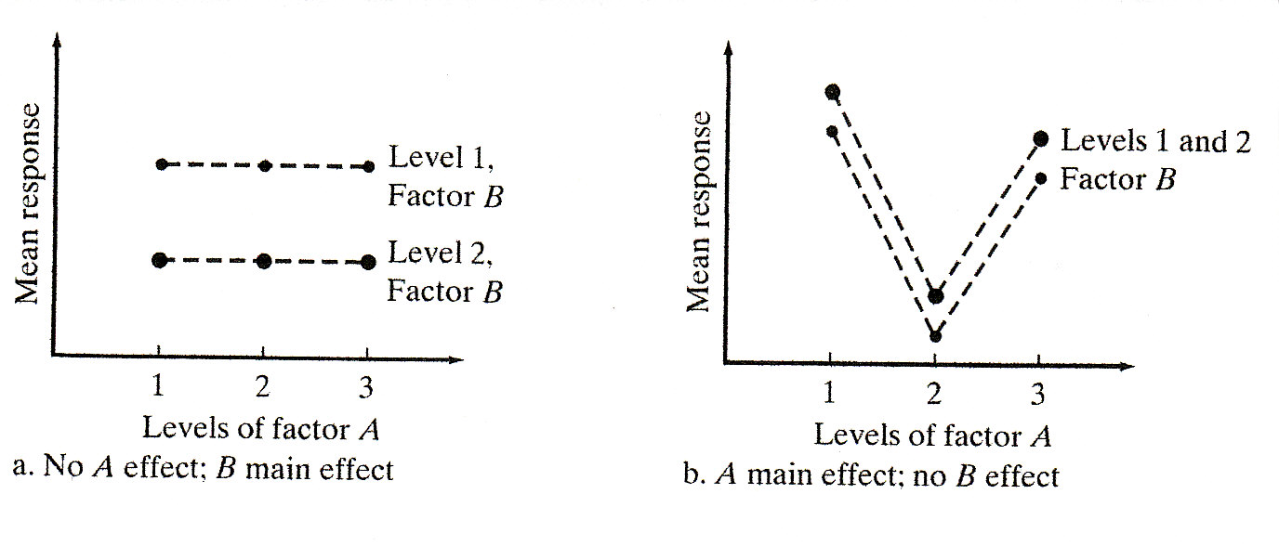

Slide 11
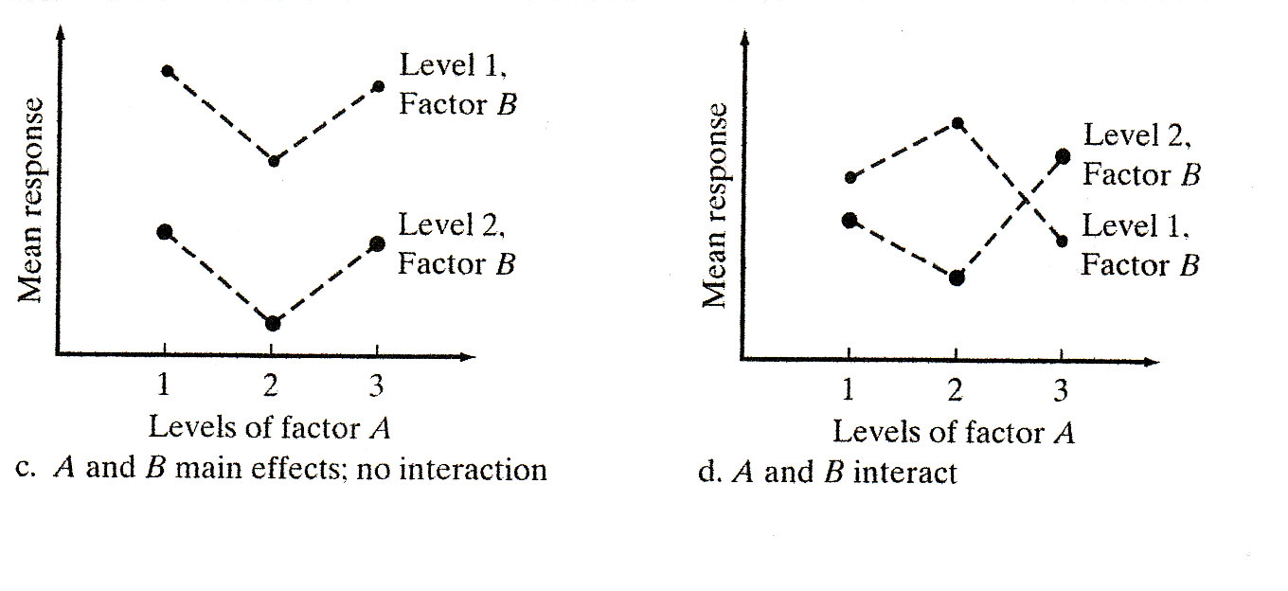

Slide 12
Two-Way ANOVA – The “Fixed Effects” Model
The model is:
where
= the grand mean for X
α_{k} = the effect for the kth level of Factor A (k=1…..r)
β_{j} = the effect for the jth level of Factor B (j=1……c)
θ_{kj}= the interaction effect for the kth level of A with the jth level of B
= the random error
As with inference for the other ANOVA, we generally require that ε~N(0,σ_{ε} ) and are independent

Slide 13
The purpose of the analysis is to discover differences between the treatment combinations. The following three hypotheses may be tested by means of F-tests:
Ho : All θ_{kj}=0 Ha: Some θ_{kj} ≠0
(Interaction)
2. H_{o} : α₁ = α₂ =. . .α_{r}= 0 Ha: Some α_{k}≠ 0
(Factor A)
3. H_{o} : β₁ = β₂ =…. β_{c} = 0 Ha: Some β_{j} ≠0
(Factor B)

Slide 14
In carrying out ANOVA, we should test the first hypothesis initially. We do so because it is important to know whether or not interactions exist.
If interactions do exist, our interpretation of the ANOVA results will be different from the case where no interactions exist.
The main effects cease to have much meaning. The F-tests on row and column treatments are hardly worth doing.
We should focus on individual cells in the table.
If there are no interactions and significant main effects, further analysis on the main effects may be conducted using the lsd post-hoc method.

Slide 15
Notation ALERT!
All textbooks use different lettering. We will use:
Factor A will be the row factor
r= # of rows
Factor B will be the column factor
c= # of columns
n= # of replications in each cell
N= total # of observations = r*c*n

Slide 16
Source of Variation | Degrees of Freedom | Sum of Squares | Mean Square | Variance Ratio, F | P-value
Factor A (row factor) | r-1 | SSA | MSA= |  | F_{r-1,rc(n-1)}
Factor B (column factor) | c-1 | SSB | MSB= |  | F_{c-1,rc(n-1)}
AxB (Interaction) | (r-1)(c-1) | SSAB | MSAB= |  | F_{(r-1)(c-1),rc(n-1)}
Error (Residual) | rc(n-1) | SSE | MSE=
Total | N-1

Slide 17
Computational Forms
SSA = ΣR²/nc - G²/N
(Sum of the squares of the row totals divided by the number of observations per row) – (square of grand total divided by the total number of observations)

Slide 18
SSB = ΣC²/nr - G²/N
(Sum of the squares of the column totals divided by the number of observations per column) – (square of grand total divided by the total number of observations)

Slide 19
SSE = ΣX² – ΣT²/n
(Sum of the squares of all the observations) – (the sum of the squares of each cell total divided by the number of observations per cell)

Slide 20
SS(Total) = ΣX² – G²/N
(Sum of the squares of all the observations) – (square of grand total divided by the total number of observations)

Slide 21
ANOVA Table – computational formulas
Source of Variation | Degrees of Freedom | Sum of Squares | Mean Square | Variance Ratio
Between Rows | r-1 | ΣR²/nc - G²/N | MSA
Between Columns | c-1 | ΣC²/nr - G²/N | MSB
Interaction | (r-1)(c-1) | By subtraction | MSAB
Residual | rc(n-1) | ΣX² – ΣT²/n | MSE
Total | rcn-1 | ΣX² – G²/N

Slide 22
Example
An amusement park has been studying methods for decreasing the waiting time (minutes) on rides by loading and unloading riders more efficiently.
Three alternative loading/unloading methods have been proposed on the three types of rides at the park.
A 2-factor design with two replications was employed in the experiment and the results were as follows. Test for any significant effects.

Slide 23
Type of Ride
M
e
t
h
o
d
 | Roller Coaster | Screaming Demon | Log Flume | Total
M₁ | 16, 18 | 19, 17 | 23, 20 | 113
M₂ | 19, 20 | 25, 23 | 19, 18 | 124
M₃ | 22, 21 | 21, 24 | 19, 17 | 124
Total | 116 | 129 | 116 | 361

Slide 24
ANOVA Table – computational formulas
Source of Variation | Degrees of Freedom | Sum of Squares | Mean Square | Variance Ratio
Between Rows | r-1 | ΣR²/nc - G²/N | MSA
Between Columns | c-1 | ΣC²/nr - G²/N | MSB
Interaction | (r-1)(c-1) | By subtraction | MSAB
Residual | rc(n-1) | ΣX² – ΣT²/n | MSE
Total | rcn-1 | ΣX² – G²/N

Slide 25
Σx² = 7351
Total s.s. = 7351 – (361)²/18 = 111
Between Methods s.s. = type a role factor
Between Ride Types s.s. = type b
Residual s.s. =

Slide 26
ANOVA Table
Source of Variation | Degrees of Freedom | Sum of Squares | Mean Square | Variance Ratio
Between Methods | 2 | 13.5 | 6.75 | 3.28
Between Ride Types | 2 | 18.8 | 9.4 | 4.56 *
Interaction | 4 | 60.2 | 15.05 | 7.31 **
Residual | 9 | 18.5 | 2.06
Total | 17 | 111.0

Slide 27
Note that, from tables,
The interaction effect has a significant impact on the waiting time. This means that the effect of the loading/unloading method depends on the type of ride.
Although the “Ride Type” is significant, main effects now cease to have much meaning.
For illustrative purposes only, the lsd for ride types is

Slide 28
Analysis of Variance for Distance, using Adjusted SS for Tests
Source DF Seq SS Adj SS Adj MS F P
Brand 3 800.7 800.7 266.9 7.79 0.001
Club 1 32093.1 32093.1 32093.1 936.75 0.000
Brand*Club 3 766.0 766.0 255.3 7.45 0.001
Error 24 822.2 822.2 34.3
Total 31 34482.0
S = 5.85320 R-Sq = 97.62% R-Sq(adj) = 96.92%

Slide 29
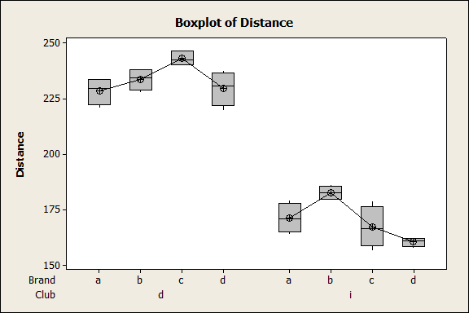

Slide 30
